Slide 1
Kernel Image Processing in CUDA environment
High-Performance Parallel Image Filtering Development
Candidato: Mattia Manneschi

Slide 2
Introduction - Problem Statement
Need for real-time, high-resolution image processing (Computer Vision, Video Editing);
Limitations of sequential CPU processing for pixel-wise operations on large datasets;
Convolution as the foundational operation for digital image filtering;
Kodak Dataset: https://www.kaggle.com/datasets/sherylmehta/kodak-dataset;
Implement a sequential CPU version as baseline for performance comparison;
implement kernel-based image processing techniques using GPU parallelization with CUDA;
compare performances;
Introduction

Slide 3
Theoretical Background
2D convolution is mathematically defined as: g(x,y) = Σ_i Σ_j f(x+i, y+j) · ω(i,j), where g is the filtered image, f is the original image, and ω is the convolution kernel. For each pixel, the operation requires K×K multiplications and sums, where K is the kernel dimension.
Kernel | Size | Application
Gaussian Blur | 3x3, 5x5, 7x7 | Gaussian smoothing
Box Blur | 3x3, 5x5, 7x7 | Uniform smoothing
Sharpen | 3x3 | Sharpness enhancement
Sobel X/Y | 3x3 | Directional edge detection
Prewitt X/Y | 3x3 | Edge detection
Laplacian | 3x3 | Omnidirectional edge detection
Emboss | 3x3 | 3D relief effect
Theoretical background

Slide 4
CUDA Architecture - Hardware used
CUDA (Compute Unified Device Architecture) is a parallel computing platform developed by NVIDIA. The CUDA architecture organizes threads in a three-level hierarchy: Grid (set of all blocks executing a kernel), Block (group of threads that can cooperate via shared memory), and Thread (minimum execution unit, each thread processes one or more pixels). Tests were executed on an NVIDIA GeForce GTX 1080 GPU, which can handle up to 1024 threads per block and up to 2048 active threads per Streaming Multiprocessor.
Specification | Value
Architecture | Pascal (SM 6.1)
CUDA Cores | 2560
Memory | 8 GB GDDR5X
Bandwidth | 320 GB/s
Base Clock | 1607 Mhz
CUDA Architecture

Slide 5
Implementation
Sequential: The CPU implementation uses a sequential approach with three nested loops: two to iterate over all image pixels and one to apply the kernel. The time complexity is O(W × H × K²) where W and H are image dimensions and K is the kernel size.
CUDA Implementations:
Global Memory: The base version uses only global memory. Each thread computes one pixel reading directly from global memory. This version suffers from high memory access latency.
Constant Memory: The convolution kernel is stored in constant memory, a read-only cache optimized for broadcast access. This reduces traffic to global memory for kernel coefficients.
Shared Memory: The most optimized version uses shared memory to create a local tile of the image. Block threads cooperate to load an image portion (including the halo needed for convolution) into shared memory, drastically reducing global memory accesses.
Implementation

Slide 6
Implementation - Sequential
Nested loops
for (int y = 0; y < height; y++) { for (int x = 0; x < width; x++) { for (int c = 0; c < channels; c++) { float sum = 0.0f; for (int ky = -half; ky <= half; ky++) { for (int kx = -half; kx <= half; kx++) { int px = clamp_coord(x + kx, 0, width - 1); int py = clamp_coord(y + ky, 0, height - 1); int img_idx = (py * width + px) * channels + c; int k_idx = (ky + half) * kernel_size + (kx + half); sum += static_cast<float>(input[img_idx]) * kernel[k_idx]; } } int out_idx = (y * width + x) * channels + c; output[out_idx] = static_cast<uint8_t>( std::max(0.0f, std::min(255.0f, sum)) ); } } }
Implementation

Slide 7
Implementation - CUDA Global Memory
Naive Parallelism - Generic pointer kernel
int x = blockIdx.x * blockDim.x + threadIdx.x; int y = blockIdx.y * blockDim.y + threadIdx.y; if (x >= width || y >= height) return; int half = kernel_size / 2; for (int c = 0; c < channels; c++) { float sum = 0.0f; for (int ky = -half; ky <= half; ky++) { for (int kx = -half; kx <= half; kx++) { int px = min(max(x + kx, 0), width - 1); int py = min(max(y + ky, 0), height - 1); int img_idx = (py * width + px) * channels + c; int k_idx = (ky + half) * kernel_size + (kx + half); sum += static_cast<float>(input[img_idx]) * kernel[k_idx]; } } int out_idx = (y * width + x) * channels + c; output[out_idx] = static_cast<uint8_t>(fminf(fmaxf(sum, 0.0f), 255.0f)); }
Implementation

Slide 8
Implementation - CUDA Constant Memory
Kernel Optimization
#define MAX_KERNEL_SIZE 7 #define MAX_KERNEL_ELEMENTS (MAX_KERNEL_SIZE * MAX_KERNEL_SIZE) __constant__ float d_kernel[MAX_KERNEL_ELEMENTS]; int x = blockIdx.x * blockDim.x + threadIdx.x; int y = blockIdx.y * blockDim.y + threadIdx.y; if (x >= width || y >= height) return; int half = kernel_size / 2; for (int c = 0; c < channels; c++) { float sum = 0.0f; for (int ky = -half; ky <= half; ky++) { for (int kx = -half; kx <= half; kx++) { … sum += static_cast<float>(input[img_idx]) * d_kernel[k_idx]; } } int out_idx = (y * width + x) * channels + c; output[out_idx] = static_cast<uint8_t>(fminf(fmaxf(sum, 0.0f), 255.0f)); }
Implementation

Slide 9
Implementation - CUDA Shared Memory
Thread Cooperation
template<int BLOCK_SIZE, int RADIUS> __global__ void convolve_shared(...) { // 1. Static Allocation of Tile + Halo __shared__ float tile[BLOCK_SIZE + 2*RADIUS][BLOCK_SIZE + 2*RADIUS]; // 2. Cooperative Load tile[ty + RADIUS][tx + RADIUS] = input[idx]; /* Border threads load the Halo (neighbor pixels) here */ __syncthreads(); // Wait for tile completion // 3. Compute using fast on-chip memory for (int ky = -half; ky <= half; ky++) { sum += tile[ty + RADIUS + ky][tx + RADIUS + kx] * d_kernel[...]; } output[idx] = static_cast<uint8_t>(fminf(fmaxf(sum, 0.0f), 255.0f)); __syncthreads(); }
Implementation

Slide 10
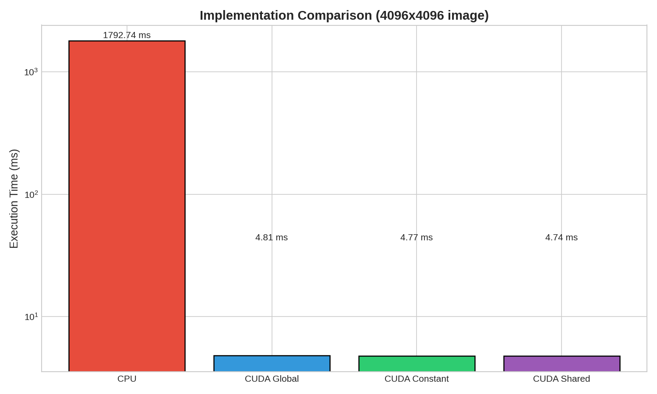
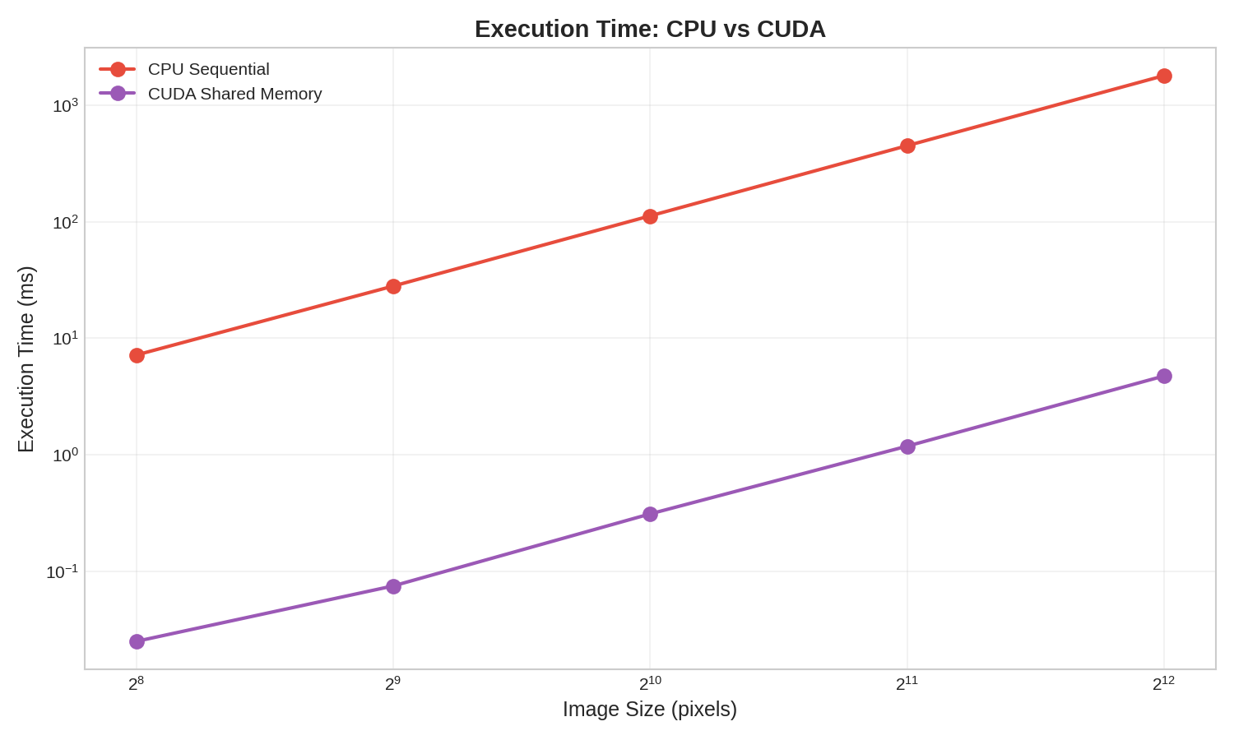
Experimental Results - Execution Time
The CPU implementation requires about 1793 ms, while all CUDA versions complete the operation in less than 5 ms, achieving an improvement of over 350 times.
Experimental Results

Slide 11
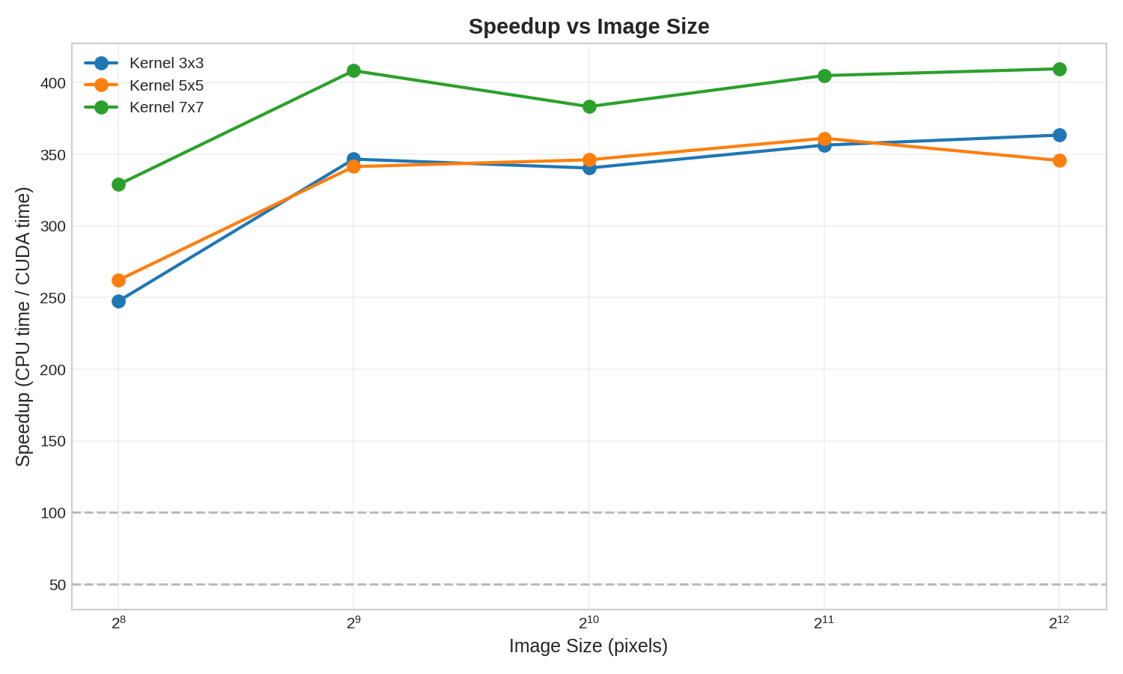
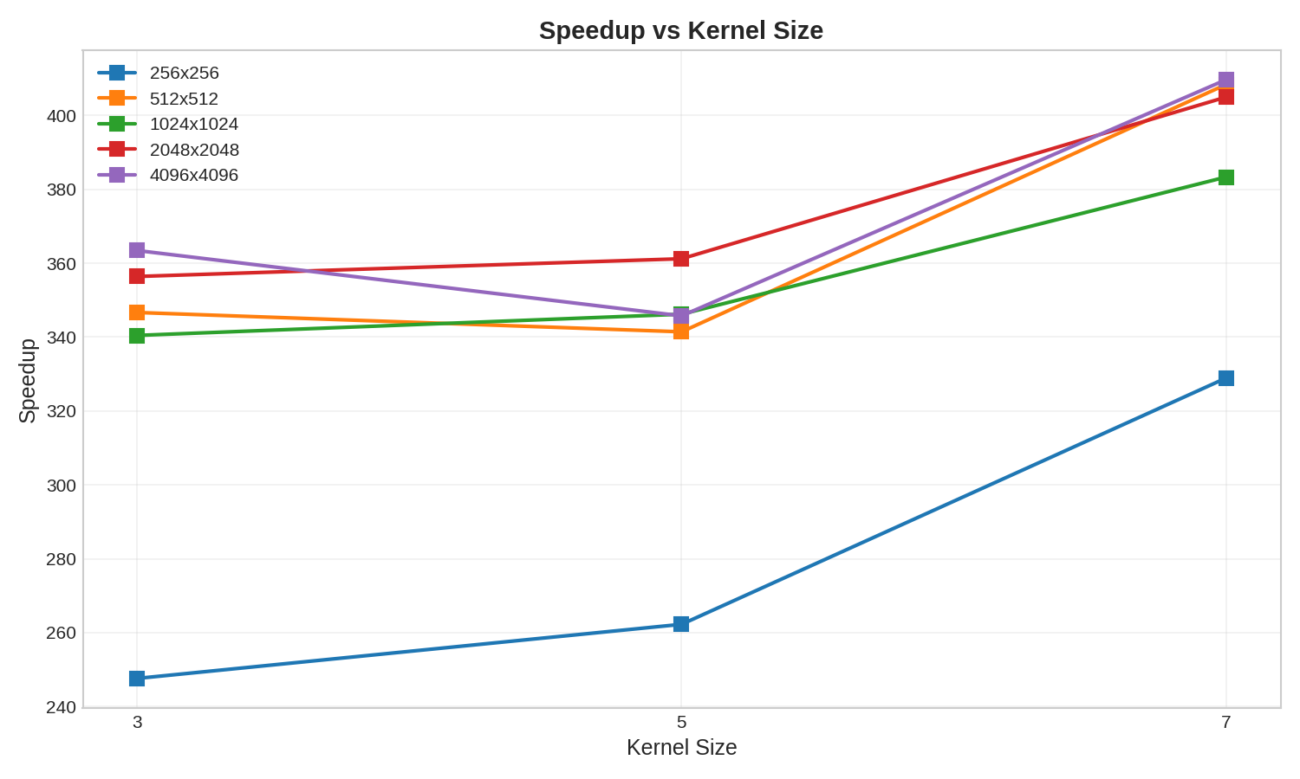
Experimental Results - Speedup
Speedup increases with image size. This behavior is expected: larger images allow better exploitation of the GPU's massive parallelism, amortizing data transfer overhead. Speedup increases significantly with larger kernels (up to 410x for 7×7 kernels). This is because larger kernels increase computational work per pixel (O(K²)), favoring the parallel approach over the sequential one.
Experimental Results

Slide 12
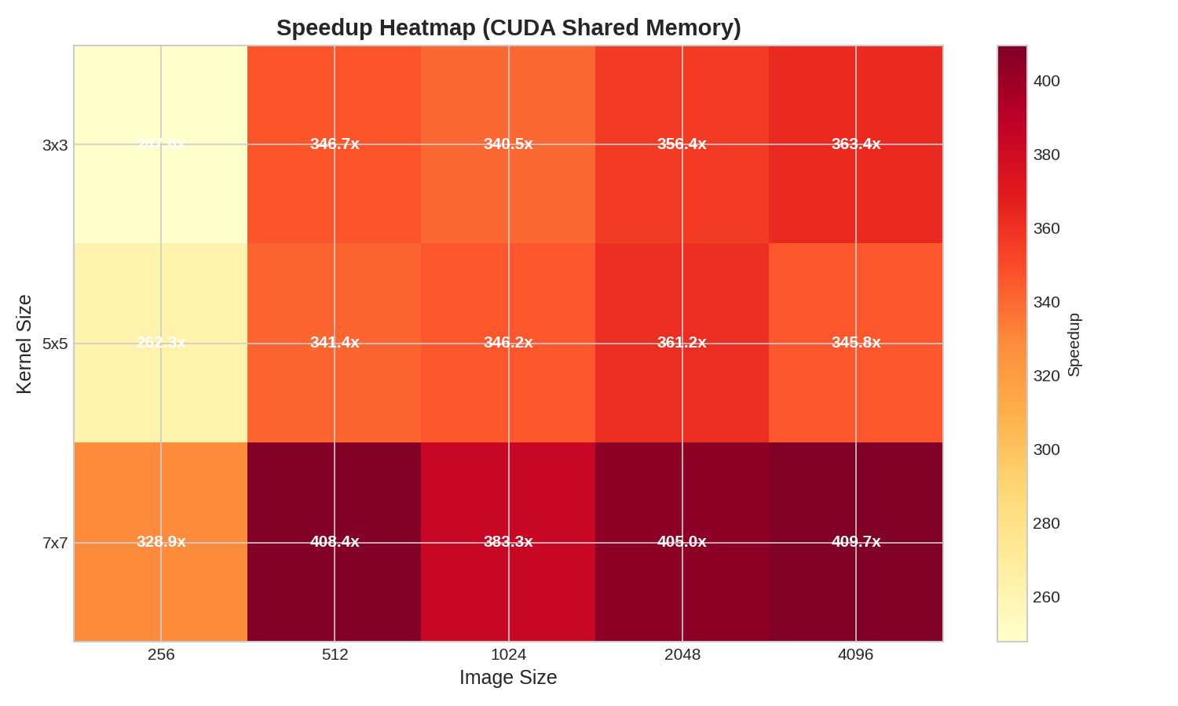
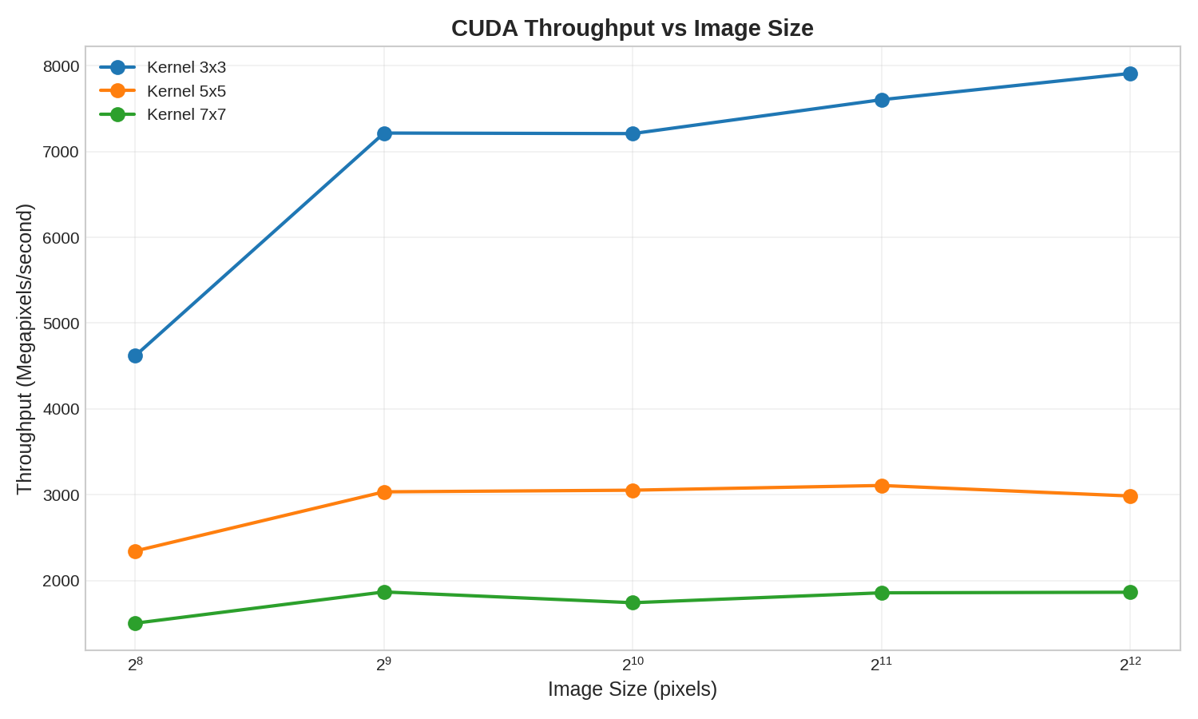
Experimental Results - Speedup Heatmap and Throughput
The heatmap shows how speedup varies as a function of both image and kernel size. The highest values (over 400x) are obtained with large images and 7×7 kernels. CUDA throughput reaches approximately 8000 Megapixel/second for 3×3 kernels, enabling real-time 4K image processing (about 3 ms per frame). With larger kernels, throughput decreases but remains in the order of gigapixels per second.
Experimental Results

Slide 13
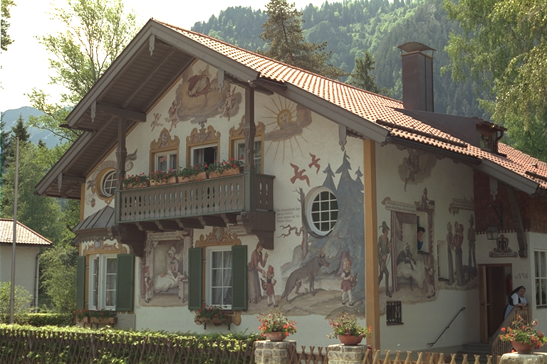


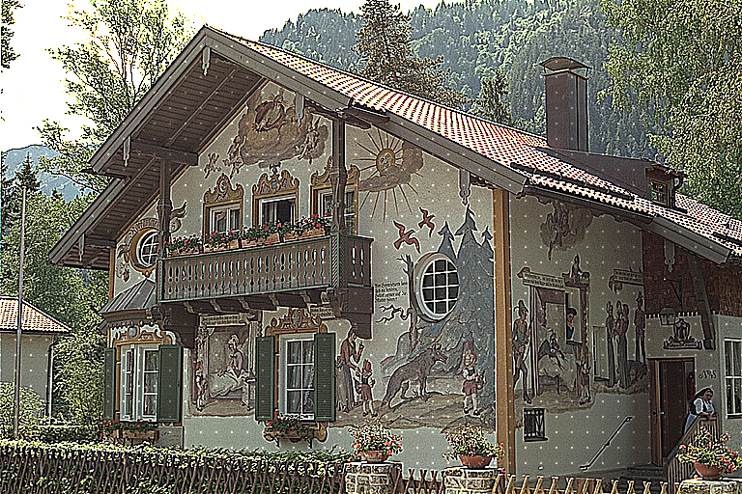
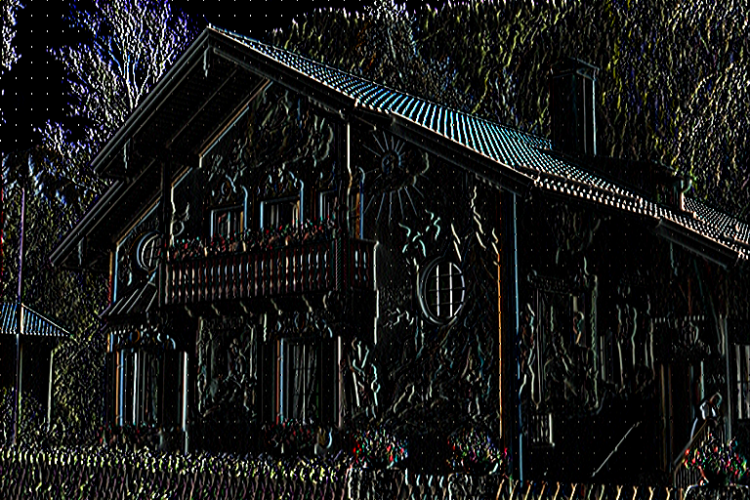
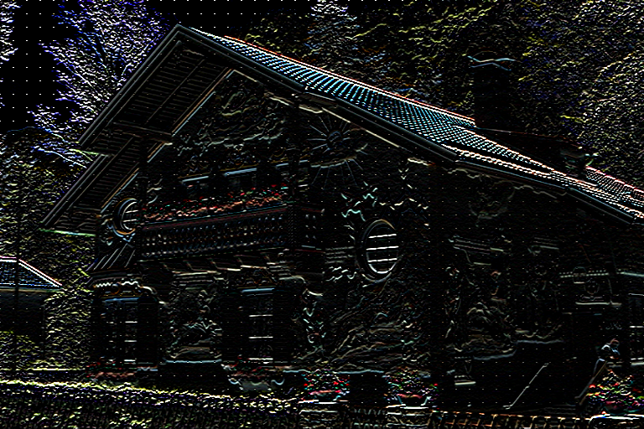
Visual Filter Examples
Visual Filter Examples

Slide 14
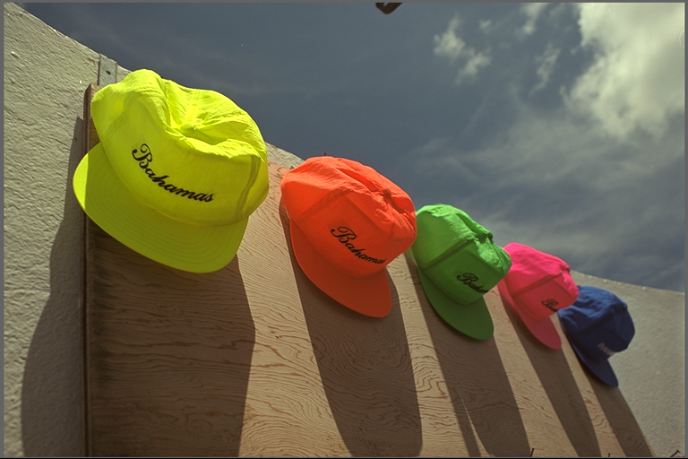


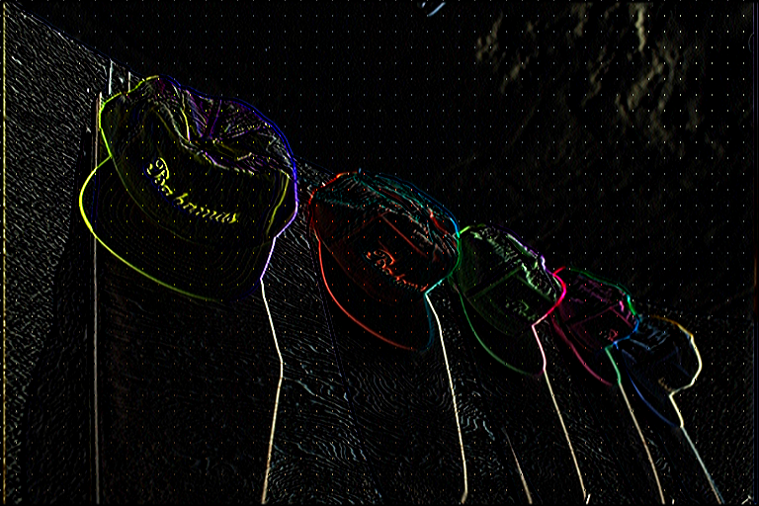
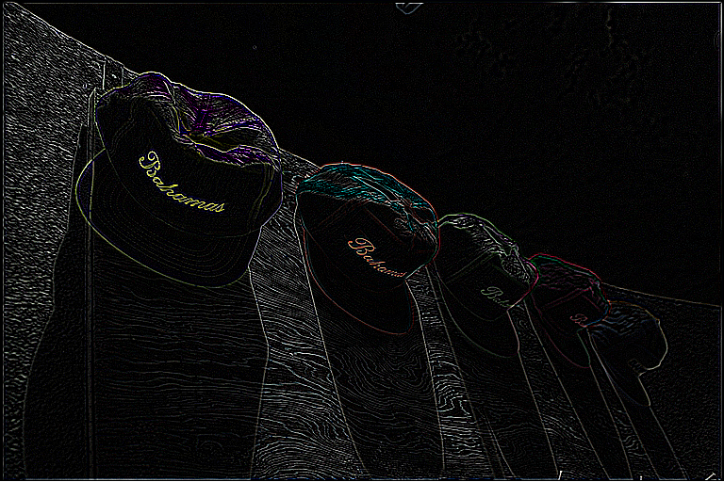
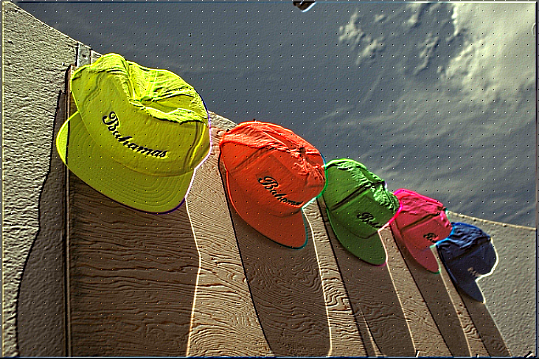
Visual Filter Examples
Visual Filter Examples

Slide 15
Conclusions and Final Remarks
The project demonstrated the effectiveness of GPU parallelization for image convolution operations. The main results can be summarized as follows:
The three CUDA implementations show very similar performance, with differences below 1%. This suggests that for this type of workload, memory bandwidth is not the main bottleneck, and shared/constant memory optimizations have limited impact. However, the speedup compared to CPU is dramatic (>300x), confirming GPU suitability for this type of processing.
Speedup increases with image and kernel size, reaching optimal values for images ≥1024×1024 and kernels ≥5×5. For small images (256×256), kernel launch overhead and data transfer reduce parallelization benefits.
Future Developments
Implementation of separable convolution (reduction from O(K²) to O(2K));
Support for batch processing of multiple images;
Implementation of more complex kernels (bilateral filter, non-local means)
Visual Filter Examples

Slide 16
Conclusion
Conclusione

